Slide 1


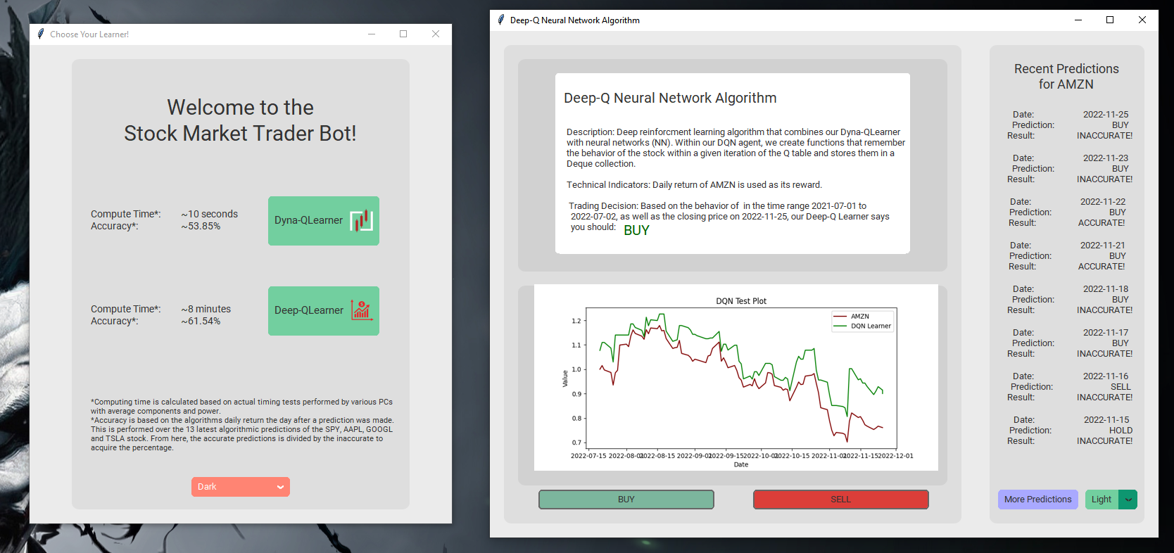
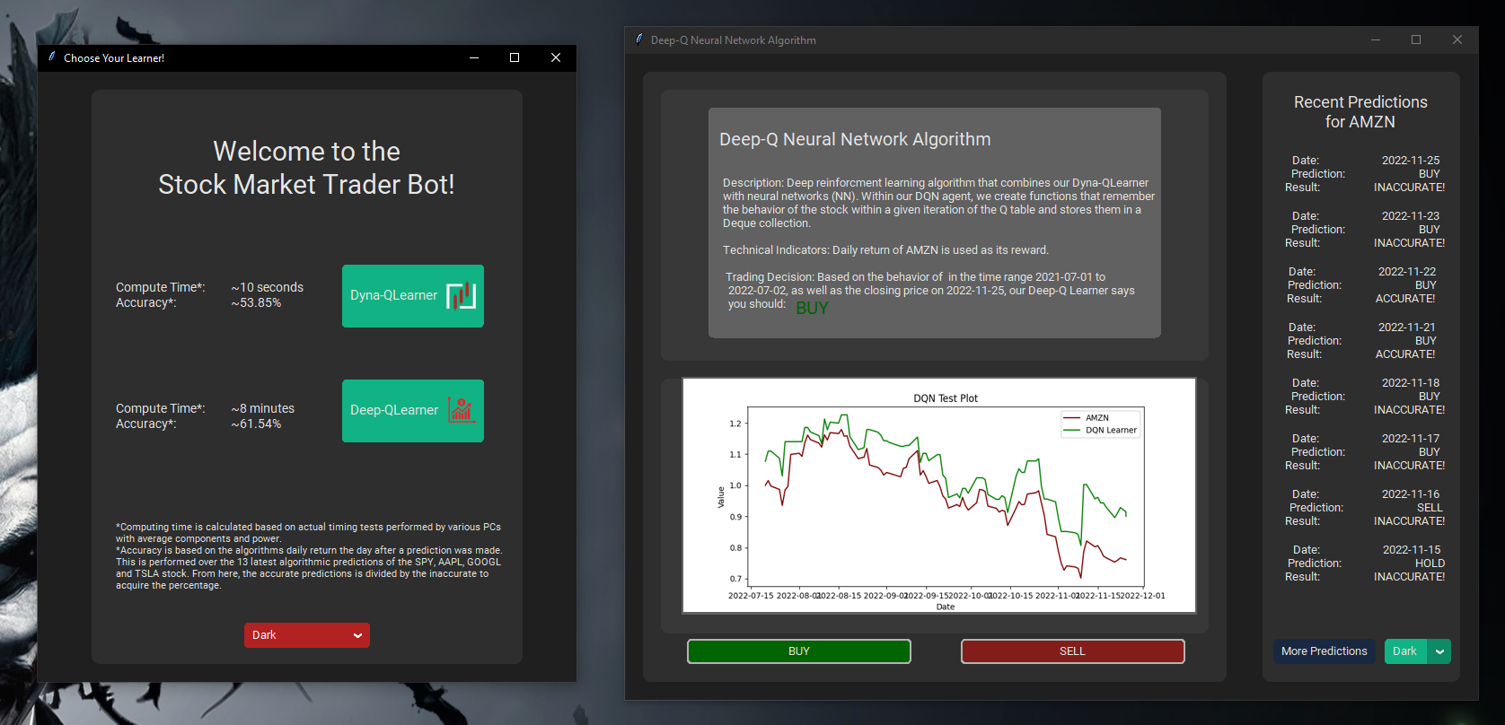
Florida International University
Fall 2022 Senior Design Project
Stock Market Trader Bot
Students: Daniel Leal, Eddie Lezama, Joseph Dabreu
Mentor: Professor Wilmer Arellano, Ph.D.
Instructor/Faculty: Professor Wilmer Arellano, Ph.D., Florida International University
User Interface
Algorithmic Accuracy
Light Mode
Strategy Dyna-Q
Out of the last 25 predictions per individual stock across four stocks (GME, TSLA, AMZN, MSFT), the Strategy-Q Learner was accurate 53/100.
Although slightly less accurate than the Deep-Q, the Strategy Dyna-Q takes less than 30 seconds to compute.
Deep-Q Neural Network
Out of the last 25 predictions per individual stock across four stocks (GME, TSLA, AMZN, MSFT), the Deep-Q Learner was accurate 59/100.
Dark Mode
As a result of the incorporation of neural networks, deep learning, training/testing various iterations, this algorithm takes almost 10 minutes to compute.
Automated Trading Using AI
Interactive Brokers and Trader Workstation
With a configured Interactive Brokers account, buying/selling stock is as easy as a click of a button.
In the near future, an option for choosing a learner to perform your trades can be incorporated.
Acknowledgement
The material presented in this poster is based upon the work supported by its participating engineers and active mentor. We/I thank Professor Wilmer Arellano for his assistance, cooperation and mentorship that I/we received throughout the senior design project.

